Slide 1
“Bushehr NPP Safety Briefing”
5-7 December, 2016
Bushehr NPP

Slide 2
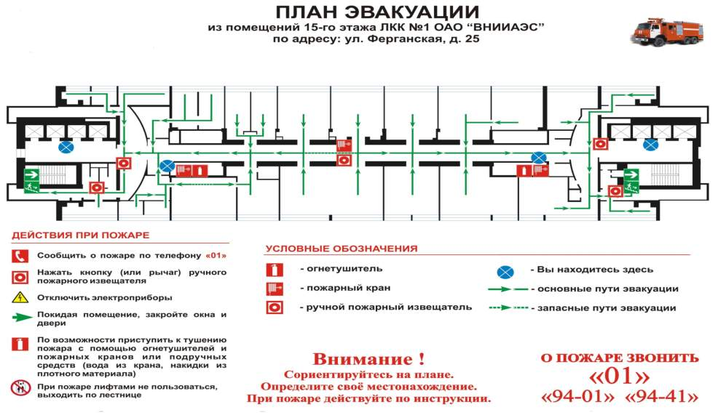
EVACUATION PLAN from G^{th} FLOOR
EVACUATION PLAN
From BTC Building 0th Floor hall
Bushehr NPP
In case of Fire
Symbols
Notify the fire by phone 01
Push button of the manual fire detector
Fire extinguishers
You are here
Fire hydrant
The main evacuation routes
Unplug electrical appliances
Push button of the manual fire detector
Leaving room-close doors and windows
Reserve evacuation routes
As possible to start extinguishing the fire using fire extinguishers and fire hydrants or improvised means (tap water, capes made ​​of thick material)
Attention!
Orient on the plan.
Determine your location. In case of fire, proceed according to the instructions
IN CASE OF FIRE
Call <125>
<115> <xx-xx>
In case of fire use emergency exits and staircases at both ends of the corridor. Do not use the elevators (lifts)!

Slide 3



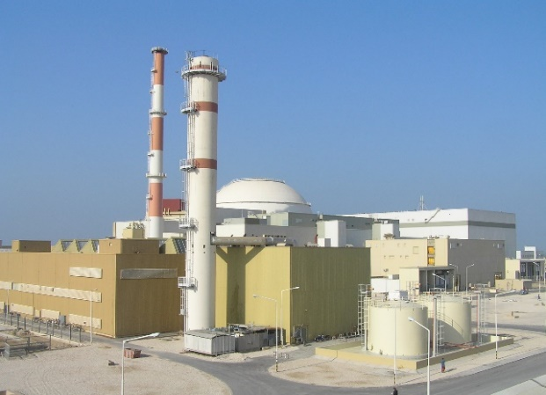
IMPORTANT
Smoking is allowed only outside of the building!
All the information during the meeting
is confidential!
Please turn off your mobile phones before each seminar presentation/discussion.

Slide 4


USEFUL
The rest rooms are at end of the corridor.
Lunches will be served in the restaurant on level «-1» (button “G” in the elevator on Administrative Building BNPP).

Slide 5
THANKS!

