Slide 1
Experience of localization
in
Major Equipment
2014. 07.

Slide 2
Background of the localization program
Contract Structure before Yonggwang3&4 NPP
(10th & 11th units in Korea)
Turnkey Base
Localization of main equipment for Yonggwang3&4 NPP
ROK gov’t established Localization Plan in 1984
Start year: 1987
Location: Yonggwang, Korea
Energy Capacity: 1,000MW/Unit
Project Owner : KEPCO
Prime Contactor: Doosan
3 units of nuclear power plants
Turnkey Contractor : Foreign Supplier
Non-Turnkey Base
6 units of nuclear power plants
Main Contractor : Foreign Supplier
Doosan’s Status before Yonggwang3&4 NPP
Status
Partially participated in manufacturing
as a sub-supplier of foreign company
- Final assembly of major equipment
Products & Services
Fossil power and industrial plant incl. desalination
Acquired ASME Stamps
1

Slide 3

Lessons leaned
Localization Phase
PWR
(APR1400)
Shin-Kori 5 & 6
UAE BNPP 3 & 4
UAE BNPP 1 & 2
Shin-Ulchin 1 & 2
Shin-Kori 3 & 4
Shin-Wolsong 1 & 2
PWR
(OPR1000)
Shin-Kori 1 & 2
Ulchin 5 & 6
Yonggwang 5 & 6
Ulchin 3 & 4
Yonggwang 3 & 4
PWR
Foreign
Suppliers
Ulchin 1 & 2
Yonggwang 1 & 2
Kori 3 & 4
`
Kori 1 & 2
PHWR
Foreign
Supplier
Wolsong 3&4
Wolsong 1
Wolsong 2
1970
1975
1980
1985
1990
1995
2000
2005
2010
2015
2020
2025
Phase I
Imported from overseas
Phase II
Era of technology self-reliance
Phase III
Export to overseas
2

Slide 4
Scope and content of the Localization
Structure
Localization Scope
Component Design
- Design engineering necessary to support
manufacturing
Equipment Manufacturing
- Manufacturing process
- Quality assurance and control
- Manufacturing facilities
Project Management
- Planning and budgeting
- Document control
KEPCO E&C
Design
Doosan
Equipment Supply
Foreign
Company
KEPCO
(KHNP)
KNF
Nuclear
Fuel
Product (Major Equipment)
Reactor Vessel and Internal
Steam Generator
Control Element Drive Mechanism
Primary Piping, etc.
3

Slide 5
Partner selection steps
Qualification
Selection
Agreement
Activities
Evaluation of each candidate’s proposal
- Proposal for
Yonggwang3&4
- Proposal for
localization
plan
The best partner considering successful localization
- Practical solution
- Range of
technology transfer
Yonggwang3&4 support contract with foreign supplier
Tech. transfer
and License Agreement
for localization
Transfer of Document and
Computer Code
Training
- CRT, OJT, OJP
Consulting Services
Cooperation with appropriate foreign partner who has proven technology and
willingness to transfer technology is essential for successful localization
4

Slide 6
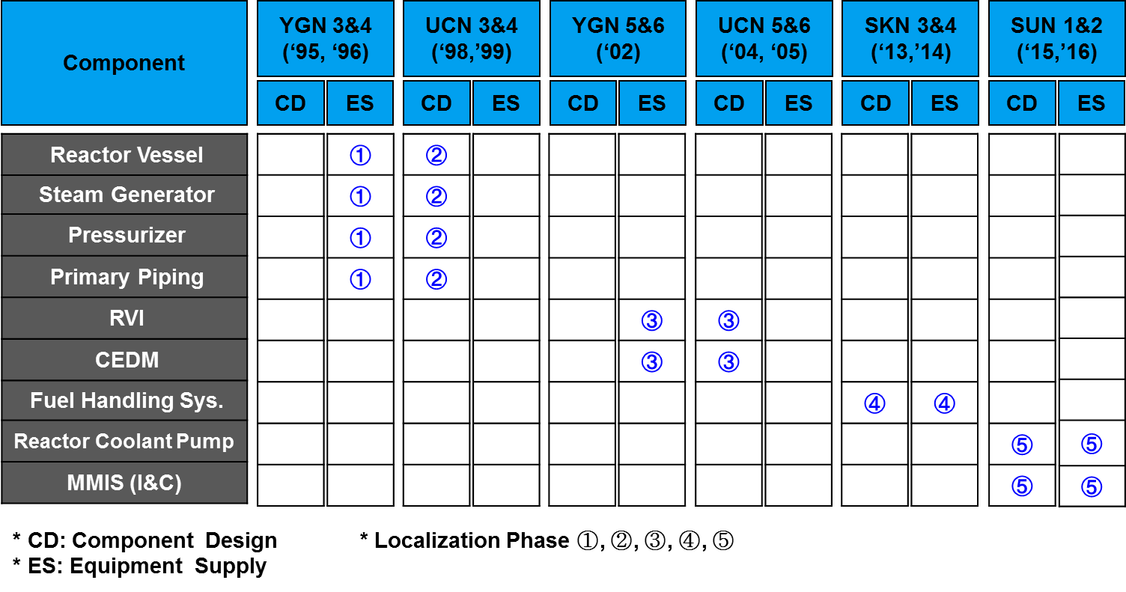
Doosan’s Localization Step
5

Slide 7
Enhancement of Manufacturing for Major Equipment
  Operation of Work Station System
  Establishment of Integrated Manufacturing Information System
  Sophistication of Core Manufacturing Technology
  Implementation of RCA(Root Cause Analysis)
6

Slide 8
Lessons leaned
Key Success Factors
Government’s strong commitment and support
Key Success Factors
Government driven policy and strong support to the local participants
Boost local companies’ participation and investment
Minimize overlapping investment of capital and duration required self reliance
Key Lessons Learned
Standardization and Replication
Repeated construction of same type reactor for local companies to build up technologies and capability
Step by Step Approach
Step by step approach with clear goal for each step to secure plant safety and performance as well as success of localization.
Over 30 years of continuous operation
7

Slide 9
Key lessons learned
Readiness of Infrastructure
Key Lessons Learned
Securing human resources and industrial infrastructure for adopting technologies being transferred
Planning and Progress Evaluation
Well planned strategy reflecting local environment
Continued monitoring the progress of technology transfer and expediting
Partner for cooperation
A partner who has proven technology and willingness to transfer technology
Maintain long-term relationship after completion of the construction
Possess deep understanding of social / business culture and project experiences
8

Slide 10
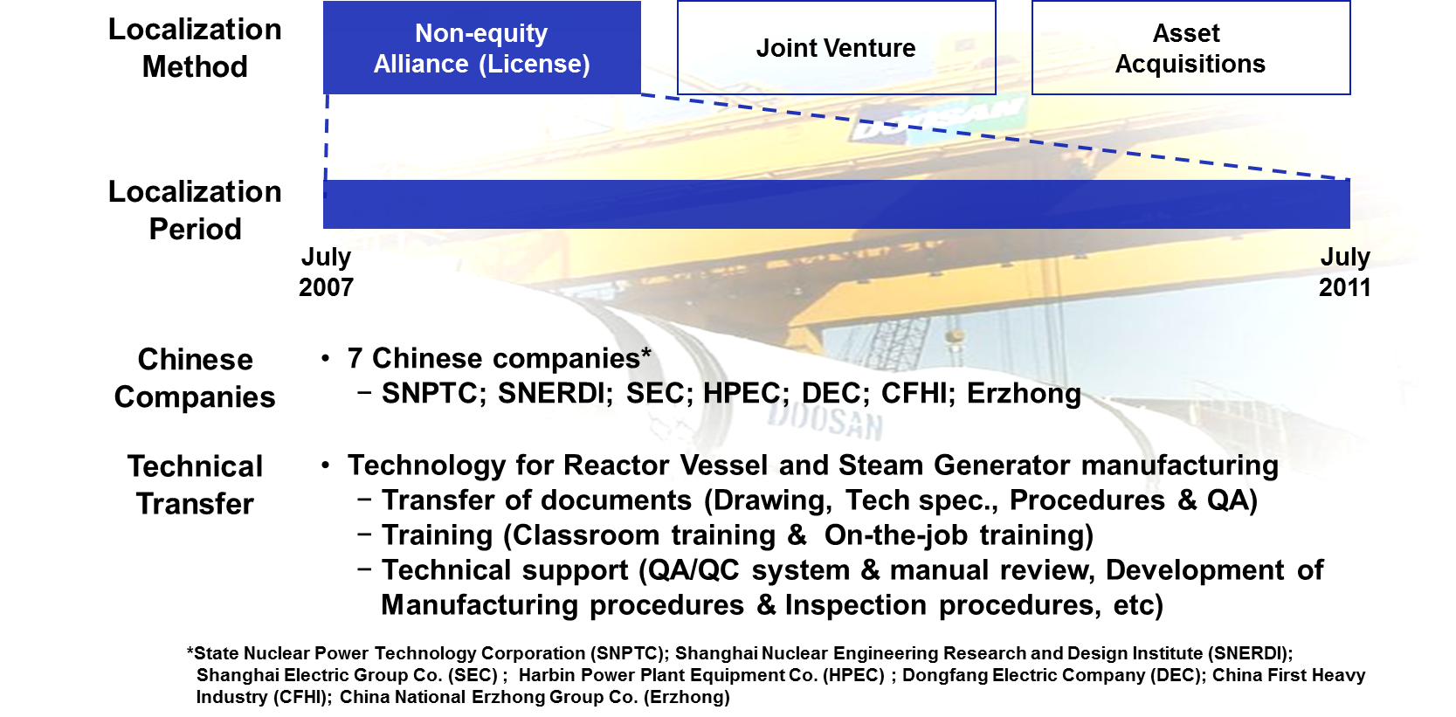
Doosan’s Technology Transfer Experience to China
9

Slide 11
Study on equipment localization
  Review of the industrial development and localization policy
  Field survey of local manufacturers
  Establishment of the roadmap and strategy for equipment localization
  Recommendation of the future prospective manufacturing items
  for each surveyed local company
  Preliminary feasibility study for the future manufacturing item
10

Slide 12

Thank You

