Slide 1
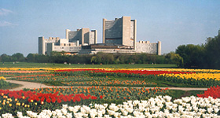
IAEA’s approach to Safety Culture
and
human & organisational factors

Slide 2
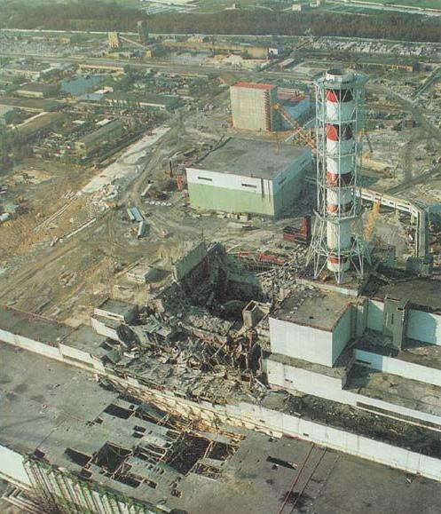
Notes:
The unexpected: It was not expected to those involved. From a distance and in hindsight it is ’all clear’, but not there and then.
It is very difficult to know what the root causes are, the cultural issues, etc.

Slide 3
The IAEA advisory group INSAG
“A vital conclusion drawn from this behaviour is the importance of placing complete authority and responsibility for the safety of the plant on a senior member of the operations staff of the plant. Of equal importance, formal procedures must be properly reviewed and approved must be supplemented by the creation and maintenance of a ‘nuclear safety culture’”.
(INSAG-1, 1986)
The concept of the safety culture was now formally introduced in the area of nuclear safety.
Notes:
Safety culture was introduced. Not the technology itself, but how it was managed.
SC, non-tangible aspects, can cause these things (switch back to Chernobyl image)
The INSAG group were also considering the national culture of Soviet union, but could not say that for political reasons

Slide 4
The IAEA advisory group INSAG
Definition of safety culture
“Safety Culture is that assembly of characteristics and attitudes in organizations and individuals which establishes that, as an overriding priority, nuclear plant safety issues receives the attention warranted by their significance”.
(INSAG-4, 1991)

Slide 5
The IAEA advisory group INSAG
Definition of safety culture
“Safety Culture is that assembly of characteristics and attitudes in organizations and individuals which establishes that, as an overriding priority, protection and safety issues receives the attention warranted by their significance”.
(The 2007 IAEA glossary)
Notes:
Revised, was made a bit broader. The word ’nuclear’ was removed, because safety is one integrated part (fire, industrial; also security).
’Nuclear plant’ was removed because IAEA work with all different organizationss that work with nuclear, incl. e.g. medical
But: Does this capture the concept of culture (from yesterday)?
Main point: the definitions are rather the tip of the iceberg, a shallow definition

Slide 6
IAEA Safety Culture Publications http://www.iaea.org
Document | Title
Safety Fundamentals No. SF-1 | Fundamental Safety Principles
Safety Requirements No. GS-R-1 | Government, Legal and Regulatory Framework for Safety
Safety Requirements No. GS-R-3 | The Management System for Facilities and Activities
Safety Guide No. GS-G-3.1 | Application of the Management System for Facilities and Activities
Safety Guide No. GS-G-3.5 | The Management System for Nuclear Installations
Safety Guide No. SSG-16 | Establishing the Safety Infrastructure for a Nuclear Power Programme
Safety Series No. 75-INSAG-4 | Safety Culture
Safety Series No. 75-INSAG-15 | Key Practical Issues in Strengthening Safety Culture
Safety Report Series No. 11 | Developing Safety Culture in Nuclear Activities
Safety Report Series No. 42 | Safety Culture in the Maintenance of Nuclear Power Plants
Safety Report Series: No 74 | Safety Culture during Pre-Operational Phases – Published Sept 2012
Safety Report Series: | How to Perform Safety Culture Self-Assessment - draft
Safety Report Series: | How to Continuously Improve Safety Culture - draft
TECDOC-1321 | Self-assessment of safety culture in nuclear installations
TECDOC-1329 | Safety culture in nuclear installations
TECDOC: | Regulatory Oversight Of Safety Culture In Nuclear Installations
Notes:
UPD

Slide 7
Safety Principle SF-1
Integrated management systems
Principle 3: Leadership and management for safety
3.12. “…Safety has to be achieved and maintained by means of an effective management system. This system has to integrate all elements of management so that requirements for safety are established and applied coherently with other requirements, including those for human performance, quality and security, an that safety is not compromised by other requirement or demands. The management system also has to ensure the promotion of a strong safety culture…”
Notes:
Emphasize integrating, no conflicts in the system is the key idea
The very top document stresses questioning and learning, and the responsibility of every individual.

Slide 8
Safety Principle SF-1
Integration of safety culture
3.13. “A safety culture that governs the attitudes and behaviour in relation to safety of all organizations and individuals concerned must be integrated in the management system. Safety culture includes:
Individual and collective commitment to safety on the part of the leadership, the management and personnel at all levels;
Accountability of organizations and of individuals at all levels for safety;
Measures to encourage a questioning and learning attitude and to discourage complacency with regards to safety.”

Slide 9
GSR Part 1: National policy and strategy
Requirement 1: National policy and strategy for safety
  2.3 (g): “The promotion of leadership and management for safety, including safety culture.”
Requirement 19: The management system of the regulatory body
  4.15. The management system of the regulatory body has three purposes: … (3) The third purpose is to foster and support a safety culture in the regulatory body through the development and reinforcement of leadership, as well as good attitudes and behaviour in relation to safety on the part of individuals and teams
Requirement 29: Graded approach to inspections of facilities and activities
  4.53. In conducting inspections, the regulatory body shall consider a number of aspects, including:
  —Management systems
  —Safety culture

Slide 10
Safety (Culture) Requirement GS-R-3
“The management system shall be used to promote and support a strong safety culture by:
Ensuring a common understanding of the key aspects of safety culture within the organization;
Providing the means by which the organization supports individuals and teams in carrying out their tasks safely and successfully, taking into account the interaction between individuals, technology and the organization;
Reinforcing a learning and questioning attitude at all levels of the organization;
Providing the means by which the organization continually seeks to develop and improve its safety culture.”
Notes:
Systemic perspective is important (individual, technology, organization)

Slide 11
Objective of the future GS-R Part 2
Leadership and Management for Safety
  The application of SF-1 to establish requirements for:
    Effective leadership for safety
    Effective management for safety
    Effective safety culture improvement activities
  Safety as a sustainable outcome of excellence in leadership and management
  Integrated management system: make sure that other requirements will not compromise Nuclear Safety
  Systemic approach of ITO

Slide 12
SSG-16: Infrastructure for new-builds
2.9. The government should also take into account:
…
—The promotion of leadership and management for safety, including safety culture (see also paras 2.142–2.157 on leadership and management for safety)
2.50. The regulatory body’s responsibilities also include:
…
—Promoting safety culture
  Action 72. The government should take into account the essential role of leadership and management for safety to achieve a high level of safety and to foster safety culture within organizations.

Slide 13

Safety culture iceberg metaphor
Behaviour
Traditions
Habits
Visible
(above the surface)
Explicitly learnt
Conscious
Easy to change
Technology
Organisation structure
Policies and Procedures
Goals
Beliefs
Non visible
(under the surface)
Perceptions
Attitudes
Implicitly learnt
Subconscious
Difficult to change
Feelings
Values
Norms

Slide 14
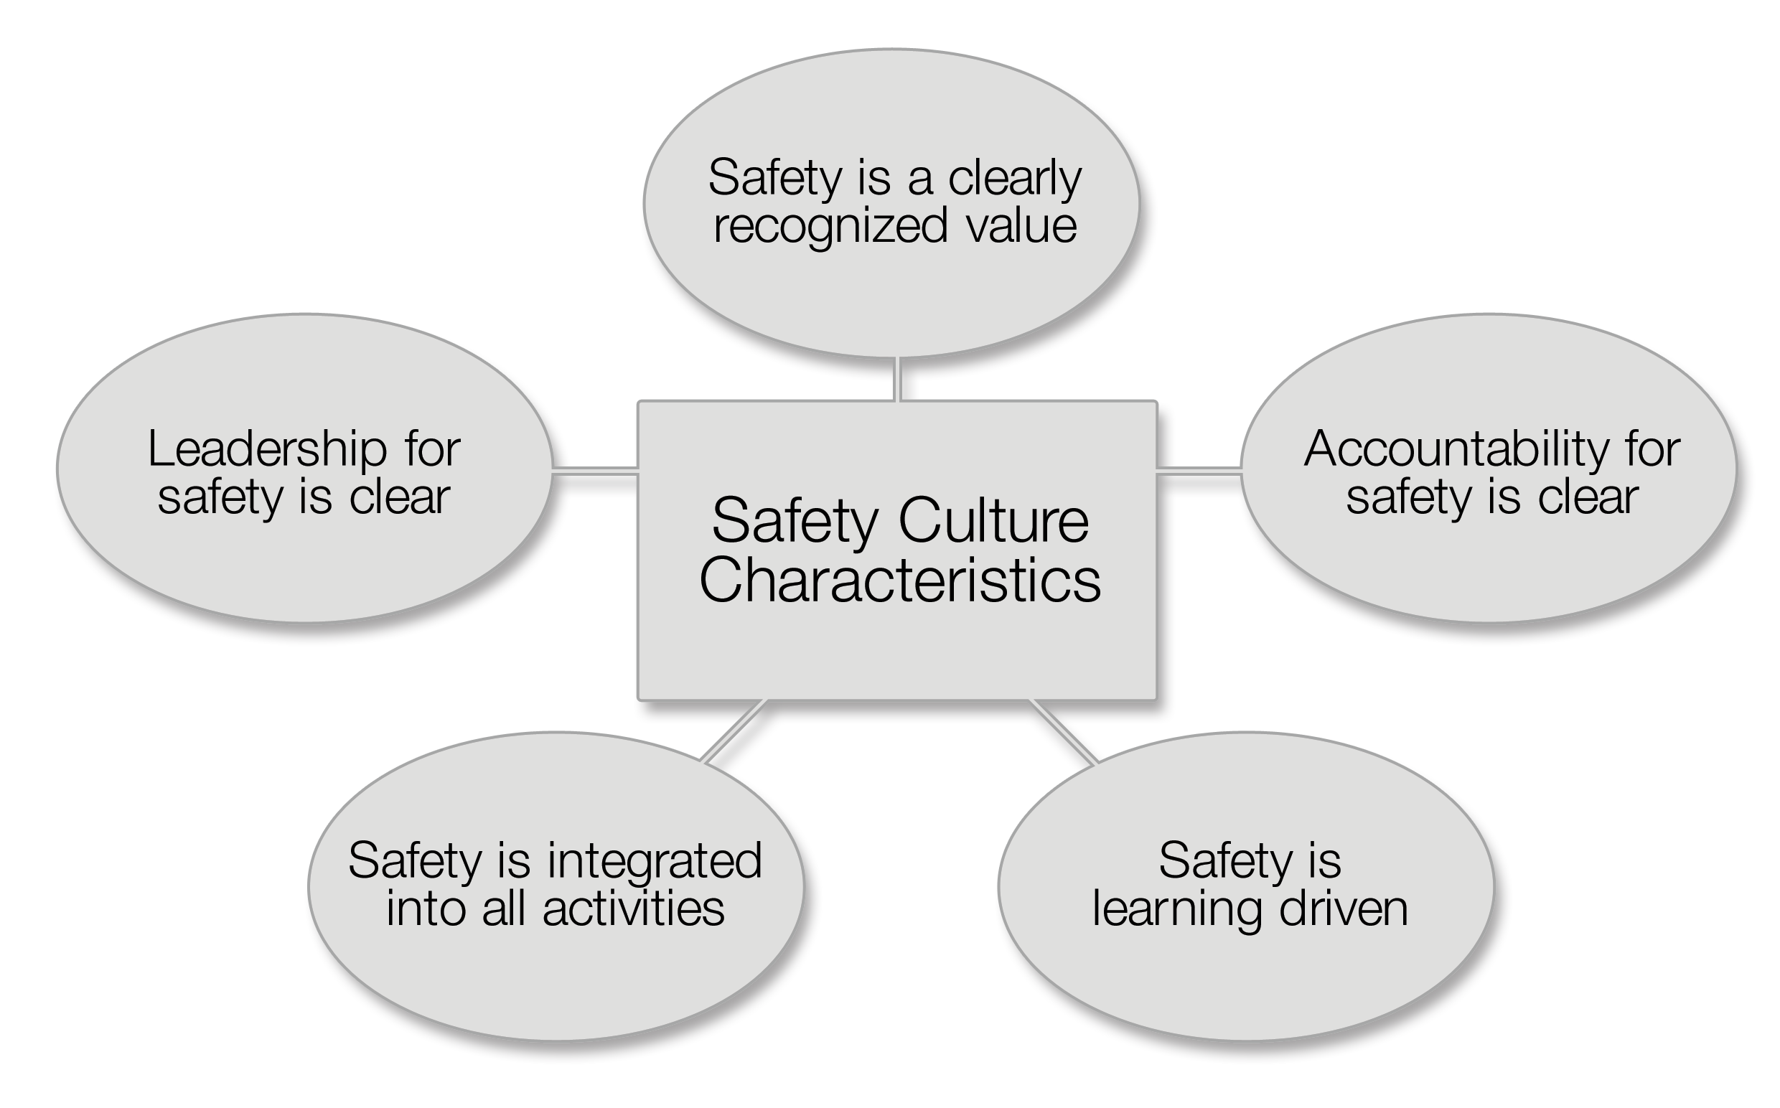
IAEA Safety culture framework (GS-G-3.1)
Notes:
14
Based on a review of what research said about safety culture and climate. Also based on accidents. Attributes are grouped into 5 characteristics.
There are different SC frameworks. You need a normative framework to compare results to. It should be research based, but not necessarily the IAEA.

Slide 15
Safety is a clearly recognized value
Attributes
High priority to safety: shown in documentation, communications and decision- making
Safety is a primary consideration in the allocation of resources
The strategic business importance of safety is reflected in business plan
Individuals are convinced that safety and production go ‘hand in hand’
A proactive and long-term approach to safety issues is shown in decision-making
Safety conscious behaviour is socially accepted and supported (both formally and informally)
GS-G-3.1
Notes:
Do not go through all five, because they will work with them later.

Slide 16
Accountability for safety is clear
Attributes
Appropriate relationship with the regulatory body exists, which ensures that the accountability for safety remains with the licensee
Roles and responsibilities are clearly defined and understood
There is a high level of compliance with regulations and procedures
Management delegates responsibilities with appropriate authority to enable accountabilities
Ownership for safety is evident at all organizational levels and by all individuals
GS-G-3.1

Slide 17
Safety is learning-driven
Attributes
A questioning attitude prevails at all organizational levels
An open reporting of deviations and errors is encouraged
Internal and external assessments, including self-assessments are used
Organizational and operating experience (both internal and external to the facility) is used
Learning is enabled through the ability to recognize and diagnose deviations, formulate and implement solutions and monitor the effects of corrective actions
Safety performance indicators are tracked, trended, evaluated and acted upon
There is a systematic development of staff competencies
GS-G-3.1

Slide 18

Safety is integrated into all activities
Attributes
Trust permeates the organization.
Consider all types of safety, including industrial and environment safety and security, is evident.
Quality of documentation and procedures is good
Quality of processes, from planning to implementation and review, is good
Individuals have necessary knowledge and understanding of work processes
Factors affecting work motivation and job satisfaction are considered
Good working conditions exists with regards to time pressures, workload and stress
Cross-functional and interdisciplinary cooperation and teamwork are present
Housekeeping and material conditions reflect commitment to excellence

Slide 19
Leadership for safety is clear
Attributes
Senior management is clearly committed to safety
Commitment to safety is evident at all management levels
Visible leadership showing involvement of management in safety related activities
Leadership skills are systematically developed
Management assures that there is sufficient and competent staff
Management seeks the active involvement of staff in improving safety
Safety implications are considered in the change management process
Management shows a continuous effort to strive for openness and good communications throughout the organization
Management has the ability to resolve conflicts as necessary
Relationships between management and staff are built on trust
GS-G-3.1

Slide 20
Safety (Culture) Guidance GS-G-3.5
Specific guidance for nuclear installations*
Further explanation of the five safety culture characteristics and the attributes
Improving safety culture
Warning signs of a decline in safety culture
Concept of interaction between individuals, technology and the organisation
Assessment of safety culture
* Nuclear power plants, other reactors (research and critical assemblies), nuclear fuel cycle facilities
Notes:
More guidance on how to live up to requirements

Slide 21
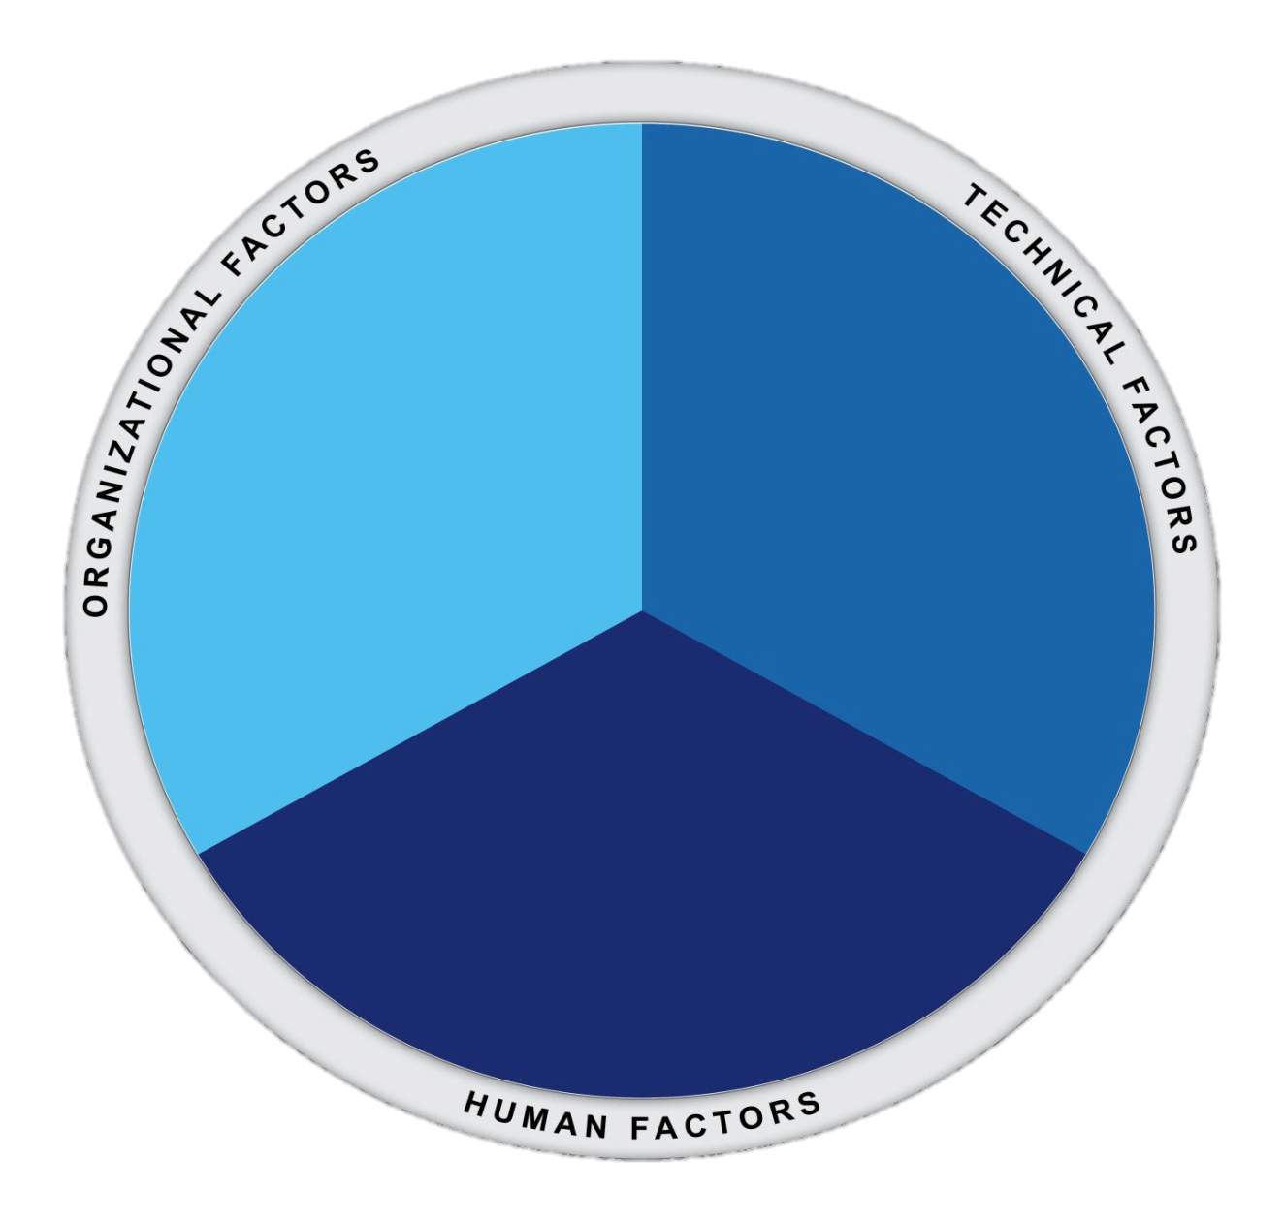
Systemic Approach – The Interaction between Individuals, Technology and Organization
Notes:
Monica

Slide 22

”Swiss cheese” model on accident causation
(James Reason)
Technology
design
equipment
tools
physical work
environment
Organisation
procedures
planning
education
communications
good organisation
maintenance
Accident
Human
competence
local knowledge
motivation
job satisfaction
22
May 2013
2013-05-27

Slide 23

Individuals, Technology, Organisation
What affects the system’s performance
Organisation
Priorities
Technology
Design
Incompatible goals
Procedures
Work environment
Training
Housekeeping
Communication
Attitudes
Psychology
Physiology
Social Psychology
Individuals
May 2013

Slide 24
System levels
Government
Regulators,
Associations
Laws
Company
Regulations
Management
Company
Policy
Staff
Plans
Work
Action
Action
Adapted from Rasmussen 1997

Slide 25
Summary
IAEA’s approach to Safety Culture is expressed in Safety Standards, Safety Reports and Technical Documents
Safety culture is an essential component of the leadership and management for safety
IAEA’s framework consists of 5 characteristics and 37 attributes that are associated with strong safety culture
Interactions between Human, Technology and Organizational Factors shall be considered at the system levels

Slide 26
