Slide 1

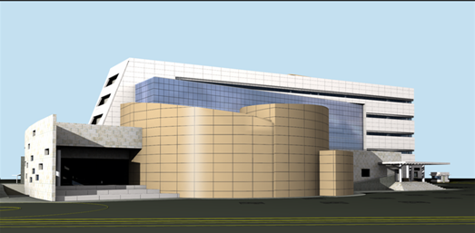
Bushehr Training & Human Resource Centre
BTC

Slide 2
Introduction:
Establishing the NPPD Training Section and Implementation of Operating Personnel Training (1998)
Training Contract, App. I to the Contract for Completion of BNPP-1
Recruitment of personnel and Establishment of Training Section in Tehran, 3 experts
Recruitment of personnel and Establishment of Temporary Training Center in Bushehr, 2 experts
Selection and Recruitment of BNPP-1 operating personnel
Implementation of operating personnel Training Programes (in Iran and Russia)

Slide 3
Objective:
Considering the necessity that a sufficient number of competent and motivated personnel shall be available for the safe and efficient operation of nuclear power plants during their entire life cycle, an appropriate nuclear power plant personnel Training System shall be established and,
Since the BNPP-1 is the first nuclear power plant in IRAN,
The IAEA was requested to assist the AEOI/NPPD in:
Strengthening the NPPD ownership in development of BNPP personnel Training System
Establishment of infrastructure for BNPP personnel training
Development of BNPP Training Centre as a key element of Training System
Training of BNPP/NPPD personnel

Slide 4


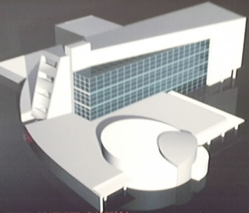
IRA/4/029 – Assistance in the Development of BNPP-1 Training System
1. Management of
TS Development
5. SAT, Training
Programmes & Materials
6. Simulators
- FSS development
-Compact Simulator Supply (Prototype-Balakovo-4, Full-Scope, Graphics interface, documentation, scenarios, instructors)
-Start up of FSS (2010)
-Evaluation of FSS
Evaluation of Training and HRM Systems
Conceptual Document on Training System
Programme for TS Development
- Training on SAT methodology & procedures of 600 BNPP-1 & NPPD staff
Specification for SAT-based training programmes
Objectives, criteria & job aids to evaluate training programmes
2. Organizational
Structure & Staffing
Establishment of BNPP-1
Training System(TS):
TS is fully designed and
essentially developed
7. CBT
Functions and responsibilities
- Training System and Training Centre org structures
- Training Centre Staffing List
- Staffed NPPD Training Section
- Partially staffed BNPP-1 TC
- Training on HRM
Specifications for CBT systems (Site Access, Regulations, Plant Systems)
Supply of CBT Site Access (all site personnel, 3 languages)
Supply of CBT
9. Sup&Mng
Training
4. BNPP-1
Training Centre
3. Policy,
Regulations
& Procedures
Specification of Training Programme for NPPD & BNPP-1
Workshop on methodology
Training sessions for NPPD & BNPP-1 managers & supervisors (Under Implementating)
Requirements & Specification for Training Centre
Training Course
Temporary good TC
Design by NPPD
2005 – start of construction
2009 – End of Construction
8. Instructor
Training
Training Policy
40 SAT Procedures
Standard on Glossary of Terms
Development of Regulations and Guides
Specification of competencies & Training Programme
Methodology
Training Workshops

Slide 5
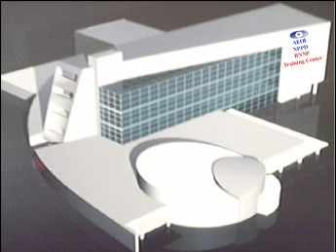
Achievements:
Achievements:
6 Training System documents developed
2 projects completed
32 Training Procedures developed
9 SOW and Technical Specifications developed
565 NPPD & BNPP personnel are trained in SAT methodology

Slide 6
The AEOI, NPPD & BNPP training system documents have been prepared under the IAEA support
No. | Title of Document
1. | Training Policy
2. | Conceptual Document on BNPP-1 Personnel Training System
3. | Glossary of Training-Related Terms For NPP Personnel
4. | The Objectives & Criteria For Evaluation of Training System & Programmes
5. | The Guidelines & Job Aids For Evaluation of Training System & Programmes
6. | Training Administrative Procedures
7. | Training Implementation Procedures
8. | Programme on Personnel Training System Development & Implementation

Slide 7
The AEOI, NPPD & BNPP training system documents have been prepared under the IAEA support
(Cont’d)
No. | Title of Document
9. | The Requirements & Specification For BNPP Training Center
10 | The Requirements & Specification For BNPP-1 FSS
11 | Technical Specification on Computer Based Training (CBT)
12 | Statement of Work on a System For Management Training
13 | Statement of Work on The Instructor Training Programme
14 | Statement of Work Compact Simulator
15 | Statement of Work on development & First run implementation of Continuing Training Program

Slide 8
The objective of Bushehr Training & Human Resource Centre establishment
1. Safe and reliable operation of the BNPP-1
2. Organize, planning and implementation of the BNPP-1 personnel training in order to establish, maintain and improve of their Knowledge & Skills.

Slide 9
Structure of Bushehr Nuclear Power Plant Operating Co.
Managing Director
Security Dept.
International & Public Relation Affairs
QA Management
IT Section
Financial & Economical Management
Chief Engineer
Administrative &
Supporting
Management
Training and
HR Centre
Safety
Division
Engineering &
Technical
Division
Production
Division
Maintenance &
Repair
Division

Slide 10
Structure of Bushehr Training and Human Resource Centre
Totally :
46 Experts
7 Technicians
Training and
HR Centre
Deputy
Office Manager
Training Section
Manager
Training Planning and
HRD Section
Manager
Simulator Training Section
Manager

Slide 11
Structure of Training Section
Training Section
Manager
Operation Personnel
Training group
supervisor
Operation Personnel
Training group
Instructors
Maintenance Personnel
Training group
Instructors
General Training
group
Instructors
Engineering Personnel
Training group
Instructors

Slide 12
Structure of Training Planning and HRD Section
Training Planning and
HRD Section Manager
Recruitment, Maintenance
and Promotion of HR group
Training Documentation &
Planning group
License & Examination
group
Psycho-Physiological
Laboratory

Slide 13
Structure of Simulator Training Section
Simulator Training Section
Manager
Simulator Training
Instructors group
Simulator Development and
Maintenance group

Slide 14
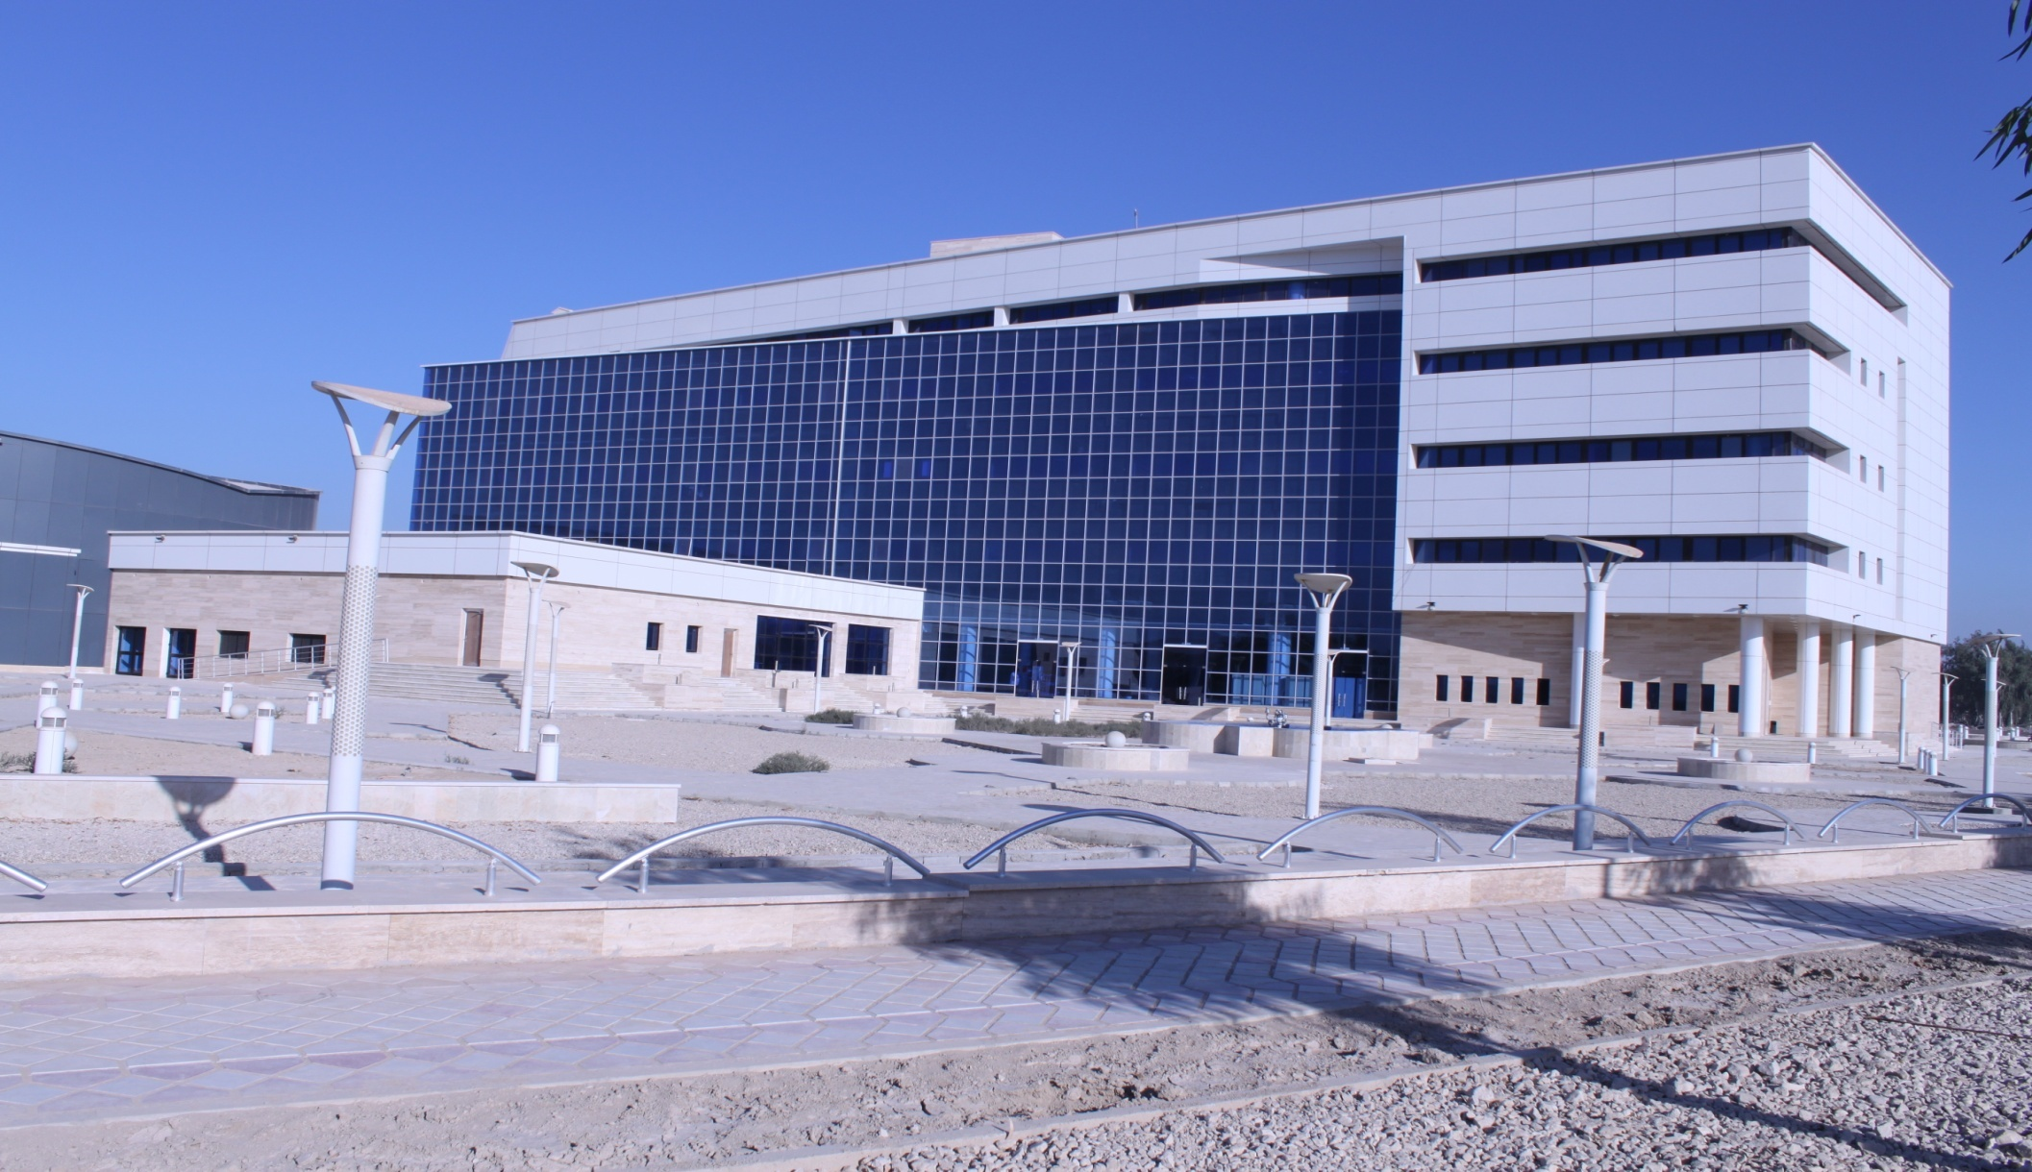
Bushehr Training & Human Resource Centre

Slide 15
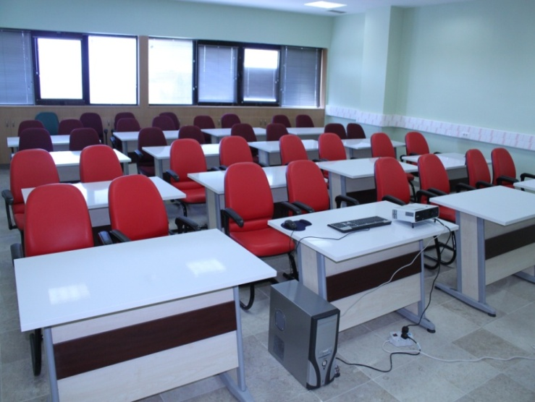
Facilities of BTC
Capacity (person) | No. | Classrooms
6 | 2
8 | 3
12 | 8
20 | 1
50 | 1

Slide 16
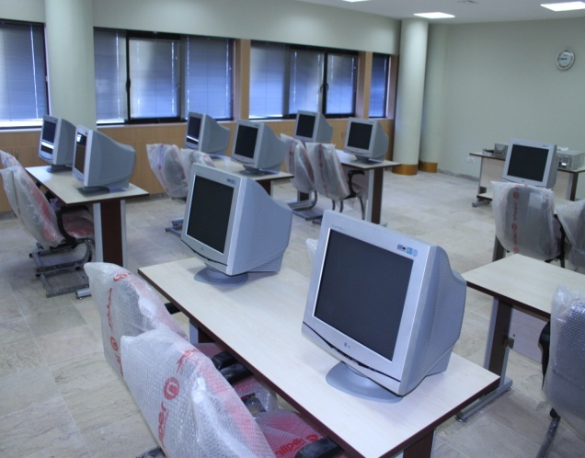
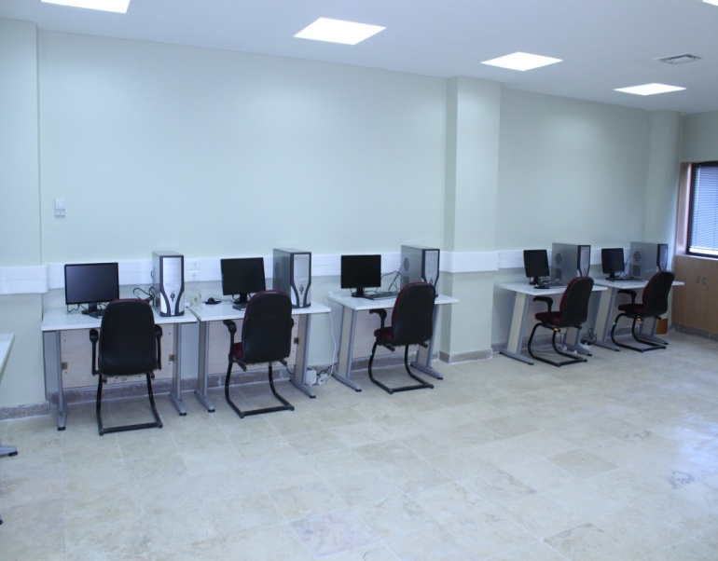
Facilities of BTC
Computer-Based Training
CBT-SA
CBT-R
CBT-M
CBT-PS&E
Self Study Classroom

Slide 17
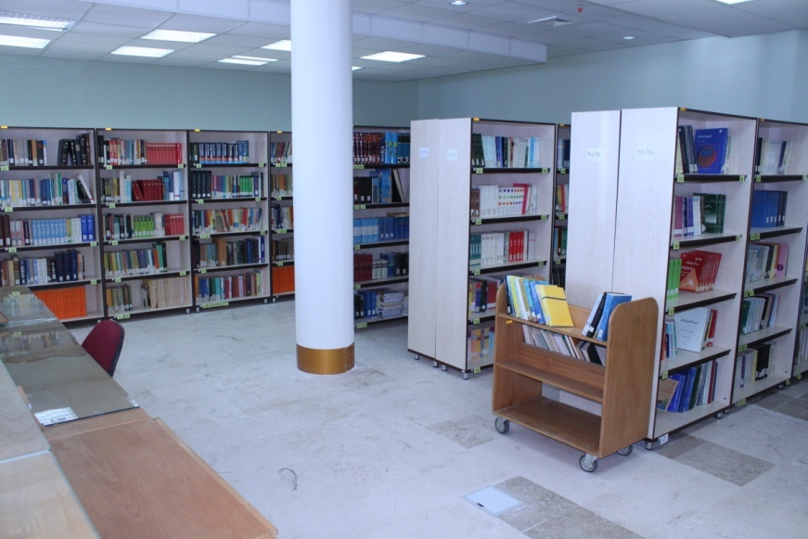
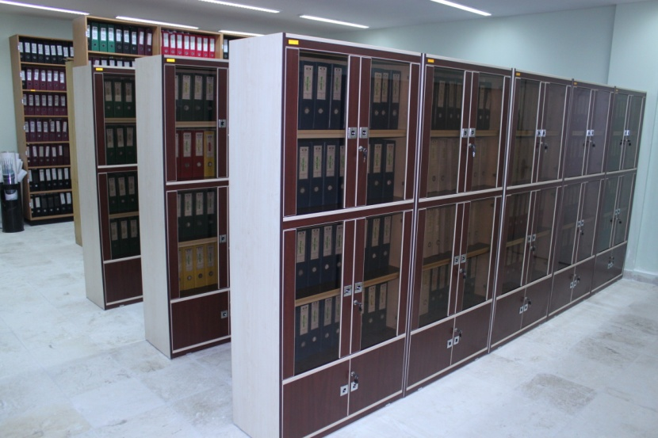
Facilities of BTC
Library
Technical Archive

Slide 18
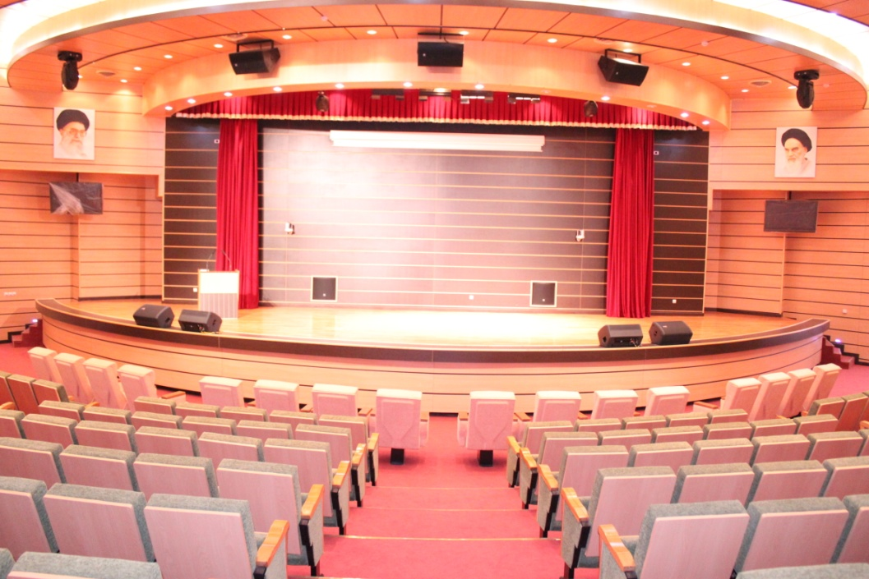
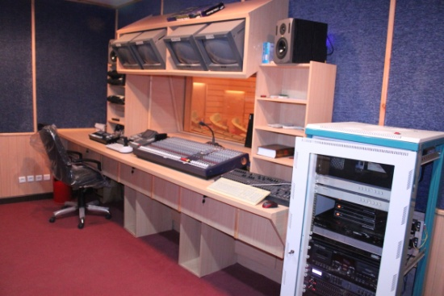
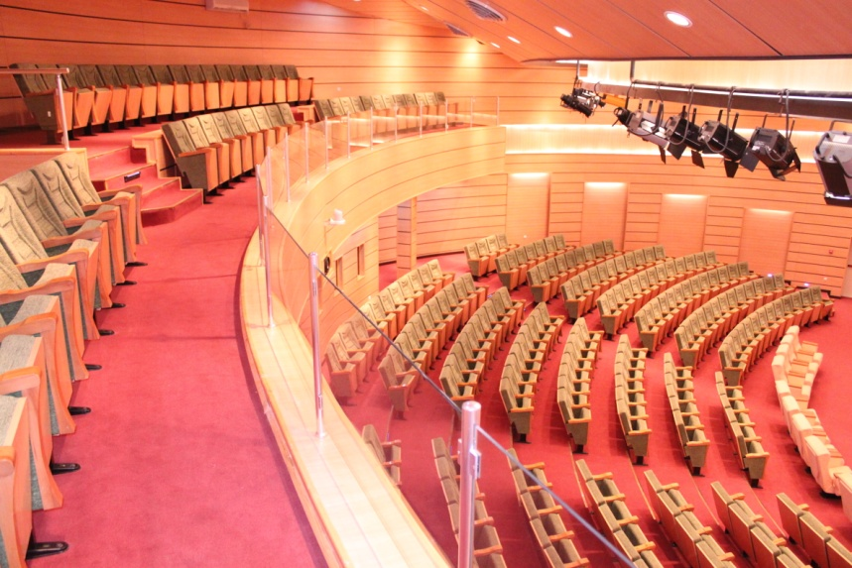
Facilities of BTC
Amphitheater

Slide 19
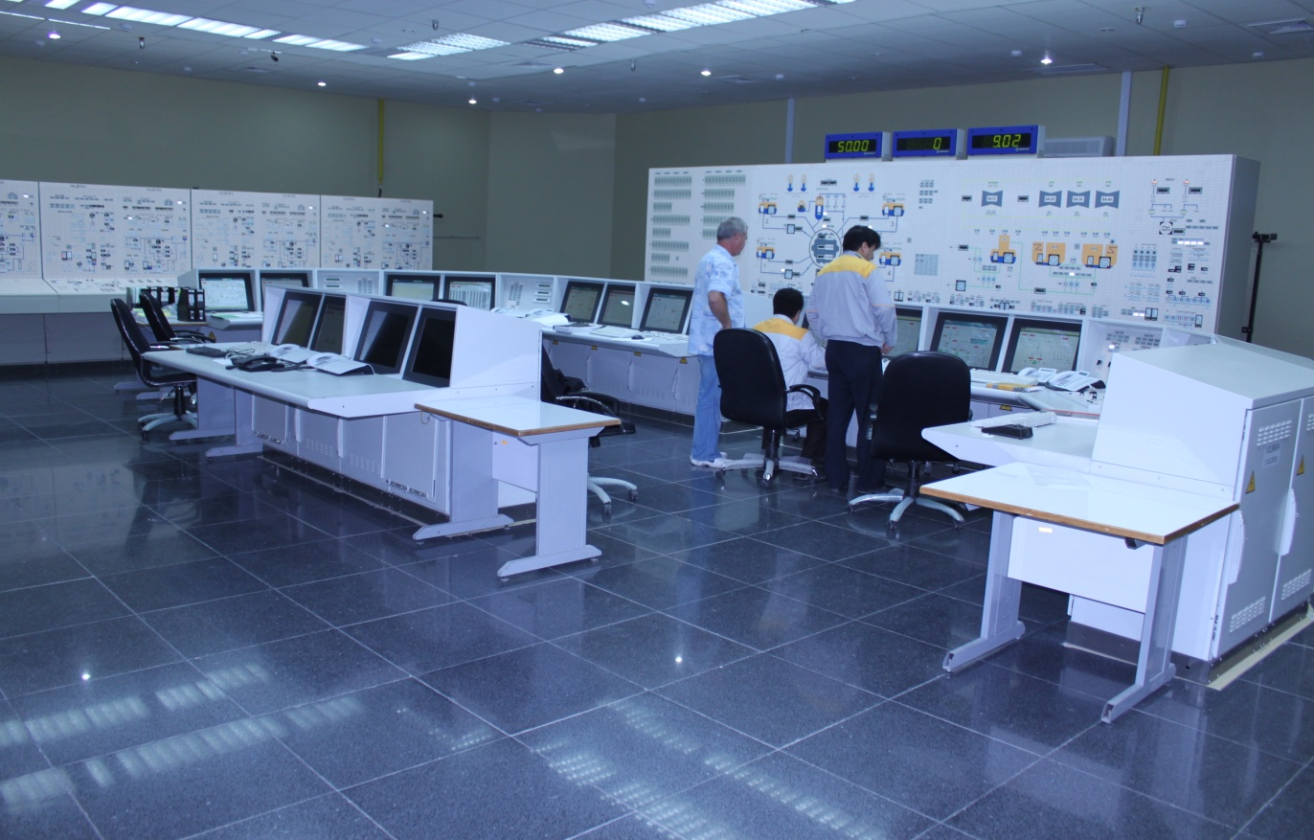
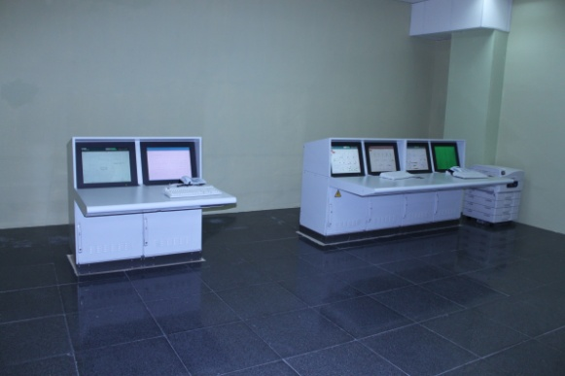
Facilities of BTC
Simulator Room

Slide 20
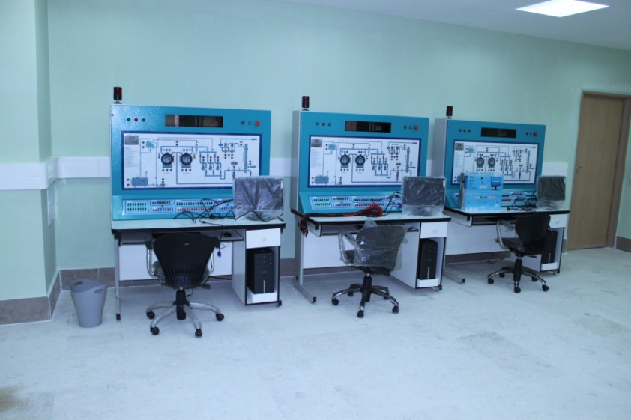
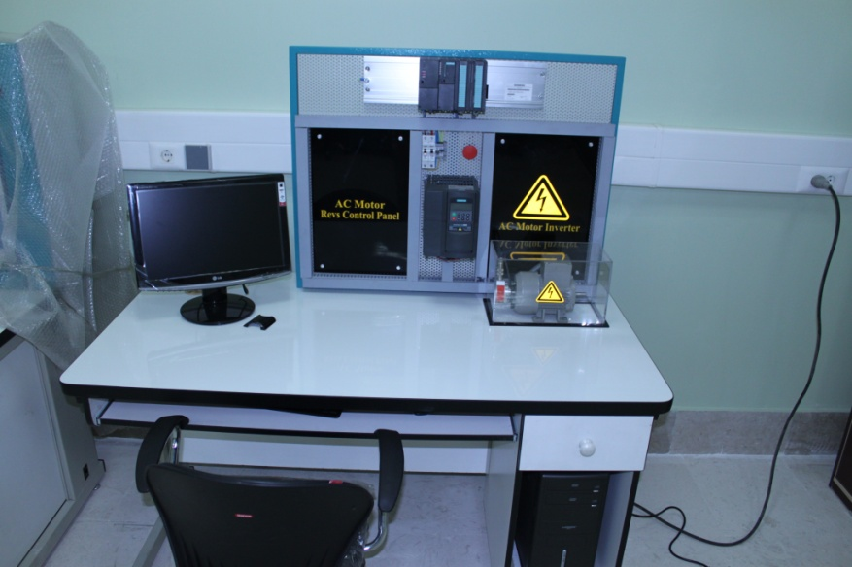
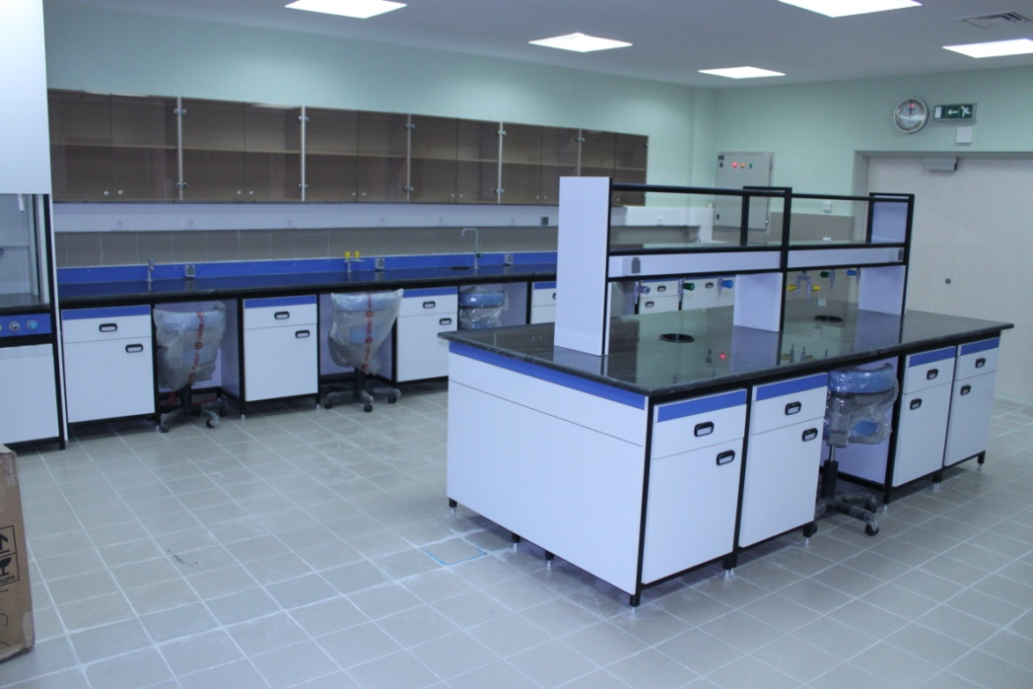
Facilities of BTC
Laboratory

