Slide 1



Cooperation of Bushehr
Nuclear Power Plant with international organizations and worldwide Nuclear Power Plants
Presented by: Ebrahim Deylami

Slide 2
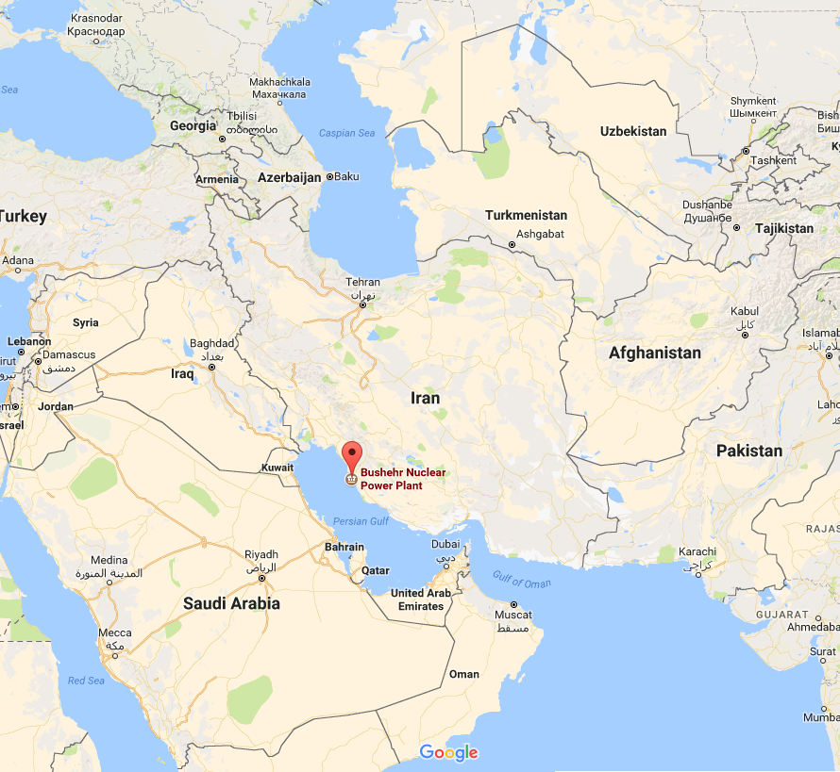
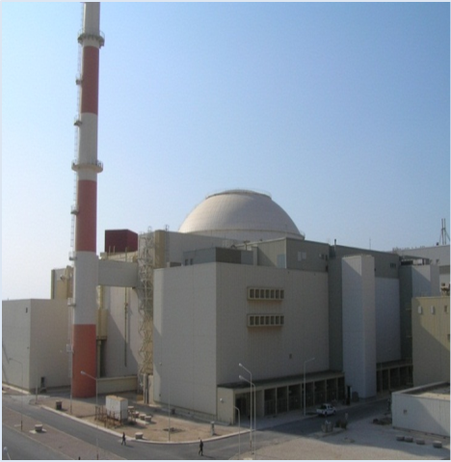
BNPP-1 Location
1000 MW Bushehr NPP is located in south west of Iran on the coast of Persian Gulf in Bushehr City.
2

Slide 3
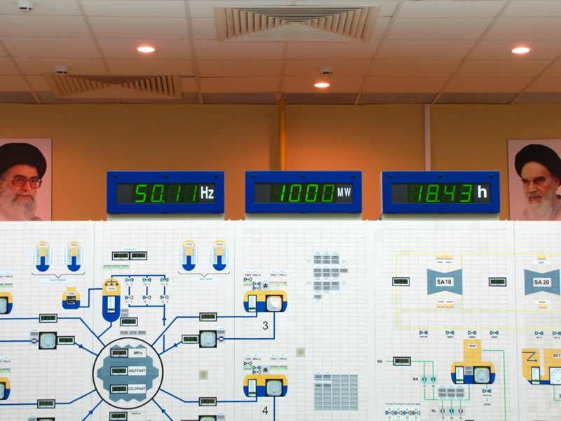
Important Events
MCL May 8, 2011
First Connection September 02, 2011
The First Time Production of Full Power (1000 MW) August 31, 2012
The provisional acceptance of the unit by BNPP 23.09.2013
3

Slide 4
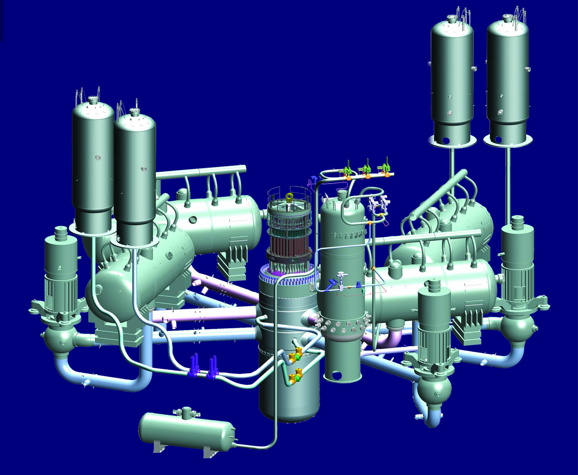
General View of Primary Circuit
4

Slide 5
Main design Parameters
N_{Э}=1000 MW | N_{T}= 3000 MW
T_{I-C(hot)}=318 ⁰C | Boric Acid injection Passive system in different pressure 60 & 25 KPa
Р_{I-C}=15.53 MPa | Dual Steel and Concrete Containment
Р_{II-K}=6.1 MPa | number of Control Rods up to 121
T_{Sea}=24.4 ⁰C | Four Safety Channels
5

Slide 6
Production and Current situation of BNPP
Up to now the amount of electricity produced by the BNPP is about 28000 GWh.
At present, BNPP is undergoing the fourth refueling cycle.
6

Slide 7
Cooperation with International organizations and NPPs
Memorandum of understanding by and between Bushehr NPP and Kalinin NPP
Memorandum of understanding by and between Bushehr NPP and Tianwan NPP
Cooperation with European Commission in the Field of Stress Test
7

Slide 8
Objective of Memorandum
The main objective of this memorandum of understanding is to create appropriate interactions, development of mutual cooperation, exchanges of information and experiences in the framework of the interests of the both parties in different areas of operating the NPPs
8

Slide 9
Areas for mutual cooperation
1- Safety:
Nuclear safety;
Radiation safety, radiation protection, and radio-ecological monitoring (environmental monitoring);
Industrial safety and work protection;
Fire safety;
9

Slide 10
Areas for mutual cooperation
2- Technical and Engineering support:
Nuclear fuel;
Increasing the lifetime and decreasing the risk of NPP Units and equipment;
Tests and examinations;
Metallurgy and welding;
Chemistry;
Ventilation;
Reactor;
Calibration;
Turbine;
Common systems;
Instrumentation and control, automatic, control and measurement equipment;
10

Slide 11
Areas for mutual cooperation
3- Technical service and repairs:
Refueling process;
Planning and organizing the repairs;
Repairing the mechanical, electrical and I&C equipment；
methods and instruments especially made for repairs;
11

Slide 12
Areas for mutual cooperation
4- Experiences and knowledge of management in the supply chain of goods and services:
Supplying the spare parts and equipment;
Manufacturing parts and equipment;
Having access to optimal order point;
12

Slide 13
Areas for mutual cooperation
OTHER Areas:
Operating the equipment and systems
Quality management system
Organizational chart of NPP
Training and qualification of staff ↑
13

Slide 14
Stress Test conducting
The objective of this project is to review the post-Fukushima nuclear safety stress test self-assessment of the Bushehr Nuclear Power Plant unit-1, in full compliance with the INRA detailed requirements of the stress test, to perform a gap analysis, to complete as necessary the self-assessment, and to envisage strategies for addressing stress test recommendations.
The kick-off Meeting of this project will be held in 28-30 April 2018 in Bushehr.
14

Slide 15
Cooperation with WANO and IAEA
Events hosted by BNPP
Year | Number of Events |  | International Experts Attended the Event
 | WANO | IAEA | WANO | IAEA
2013-2017 | 31 | 18 | 169 | 60
Events in which BNPP experts attended
Year | Number of Events |  | Bushehr NPP Experts Attended the Event
 | WANO | IAEA | WANO | IAEA
2013-2017 | 98 | 24 | 123 | 72
15
Notes:
In this slide, you can see the statistics of extensive programs which BNPP ,WANO and IAEA specialists held together in the form of training workshops, technical visits and technical support in various areas. As you see during 5 years since 2013 to 2017, as an average BNPP hosted six activity or events including workshop, technical meeting or … with about thirty-four experts from WANO and more than tree events with twelve experts from IAEA in each year.

Slide 16
National & international audit & Reviews
National reviews by Regulatory Authority: 87 reviews
WANO Pre-startup Peer Review
WANO- Peer Review
OSART Preparatory Meeting
WANO Follow-up Peer Review
Conducting OSART Review
WANO Follow-up Peer Review
1998-2016
10-23 Nov 2011
02-06 Nov 2013
01-17 June 2015
14-16 Nov 2016
4-8 Nov 2017
29 Sep-17 Oct 2018
16

Slide 17
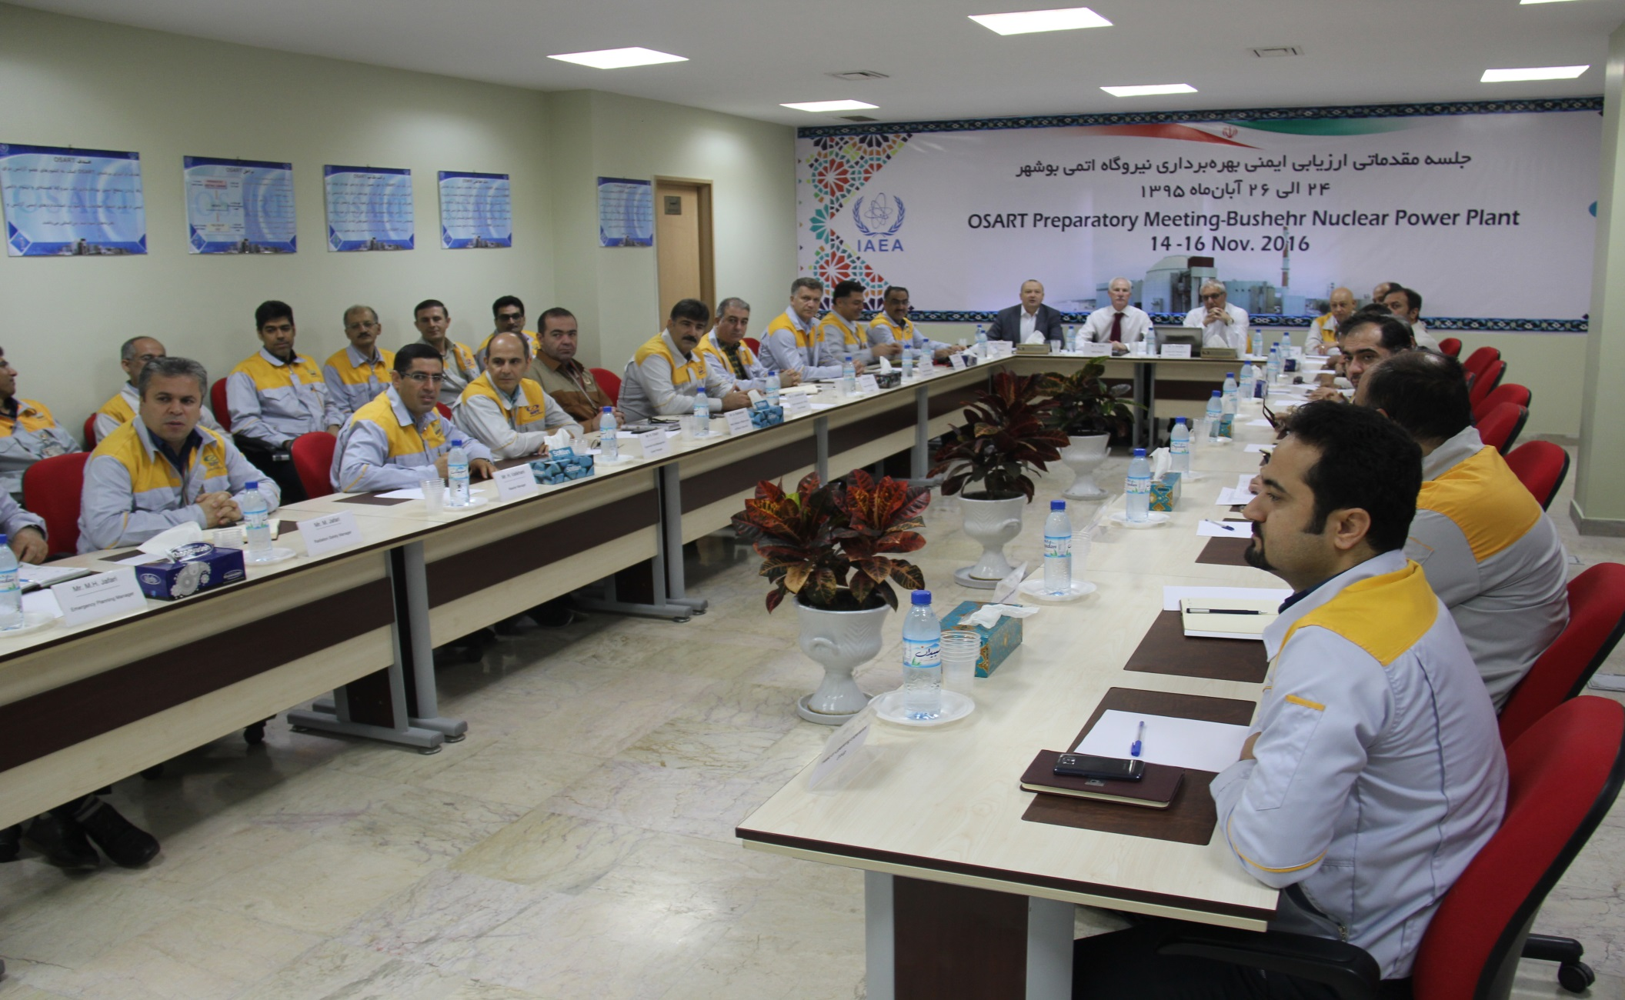
17

Slide 18

Capacity Building
Concerning the “Capacity Building” issue at BNPP-1, the following should be taken into account :
The unique design of BNPP-1 and the first experience of NPPD in the field of Nuclear Power Plants (NPPs) Operation
The need to supply the spare parts
The need to perform the repairs of main equipment, specially the primary circuit , and to train the repair staff
Based on what said above, several contracts were concluded.
18

Slide 19
Capacity Building
Technical Support Contract
Contract with Equipment Manufacturers for Supply of Spare Parts
Contract for Performing the Repair of Important Equipment
Contract for Providing Specialized Training for Repair Staff
19
Notes:
Also during the operation, we have obtained the necessary technical support in the different technical areas from authoritative companies and centers involved in designing, constructing and commissioning the NPP’s through signing contracts and memorandum of understanding.

Slide 20
Thank You for Your Attention

