Slide 1

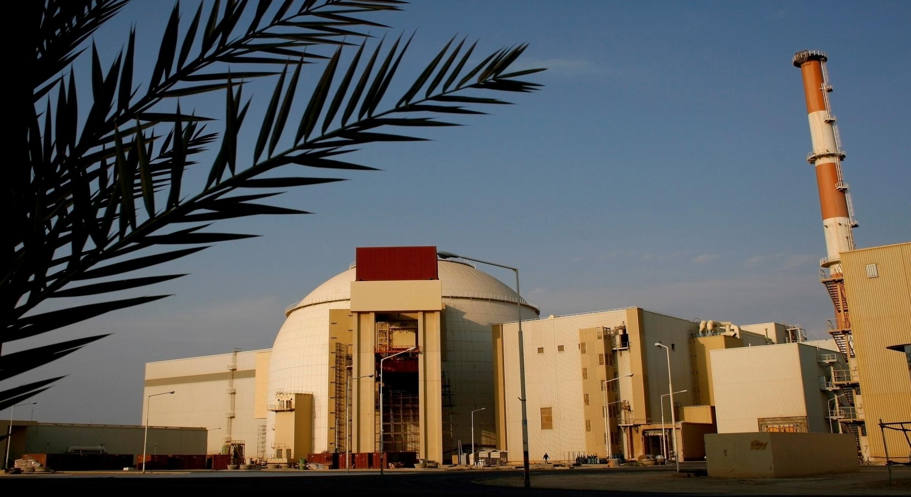
National’s and NPPD’s Plan for Nuclear Power Development for the period of five years
Nuclear Power Production & Development Co.
M. Ahmadian
Vice President of AEOI and NPPD Managing Director
Feb 2015

Slide 2
Contents
Long-term View for National Nuclear Power Development
Objectives in the State’s 5th development plan (Mid- term Planning )
Expectations and needed further assistance from the IAEA

Slide 3
Long-term View for National Nuclear Power Development
Diversification of production methods and upgrading energy security,
Sustainable development and global common responsibility,
Gaining the technologies for establishment and development of nuclear power plants,
A reasonable share of nuclear power generation in the total power generation of the country,

Slide 4
Long-term View for National Nuclear Power Development
The council of Nuclear Energy of Iran has decided that the Iranian nuclear power generation capacity should reach 8000 - 10000 MW by the year 2030,
On the basis of 2005 law that has been ratified by Iranian Parliament, total nuclear electricity generation capacity has been set to 20,000MW for the coming three decades,
taking into consideration of national economic needs and Recent Study in 2010 (conducted by NPPD), it is justified to decide for construction of further NPPs to supply 8112 MWe and deliver it to national grid ,during the Power Plants Planning to be developed for 20 years to 2030.
To produce electricity from nuclear power plants, Pressurized Water Reactors(PWR) will be developed.

Slide 5
Objectives in the State’s 5th development plan
(Mid–term Plan for Nuclear Power Development)
Safe and Reliable Operation of Bushehr Nuclear Power Plant – Unit1,
Design and construction of Medium sized nuclear power with PWR plant using capacities of Iranian companies,
Implementation of detailed studies, taking possession of and preparing the sites for construction of new nuclear power plants,
Starting the activities for construction of 4000 MW of nuclear power plants including 2 new large scale (PWR) at Bushehr site.
Training of expert manpower in the field of nuclear science and technologies in line with national plan for the NPP development.

Slide 6
Updated NPPD, nuclear power development plan for 2 new large scale PWR units of Bushehr site
Main tasks and milestones:
Negotiation between NPPD and Rosatom (ASE)
Completion of the technical studies and technological requirements related to the Construction of the new units
Programs for national participation and Human Resource Development
Intergovernmental agreement signed between AEOI & Rosatom - Nov, 2014
Contract of 2 units signed by NPPD and ASE -Nov, 2014
Site Engineering survey Started -Nov, 2014
Final commitment and Submission of documents for construction licence - 2015
Finalization of Environmental Report with updated site specific data and analysis
Application for necessary permits/licenses (site, design, construction),
First Concrete by 2017
Expected Commissioning Unit1 - 2024 & Unit2 – 2026.

Slide 7
New Nuclear Units -BNNP 2 & 3
New Project preliminaries & Milestones
Completion of Nuclear Power Planning for Electricity Production by ~2030
2010
2011
Completion of the technical studies and technological requirements related to the Construction of the new units
2012-13
Negotiation between NPPD and Rosatom (ASE)
Intergovernmental agreement signed between AEOI & Rosatom,
Contract of 2 units signed by NPPD and ASE,
Site Engineering survey Started
Nov. 2014
Next
Final commitment and Submission of documents for construction licence
2015
2024
Commercial operation, BNPP Unit 2
2026
Commercial operation, BNPP Unit 3

Slide 8
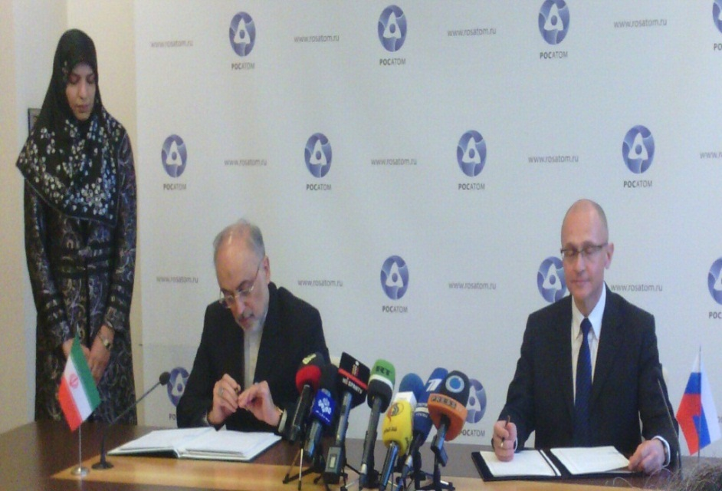
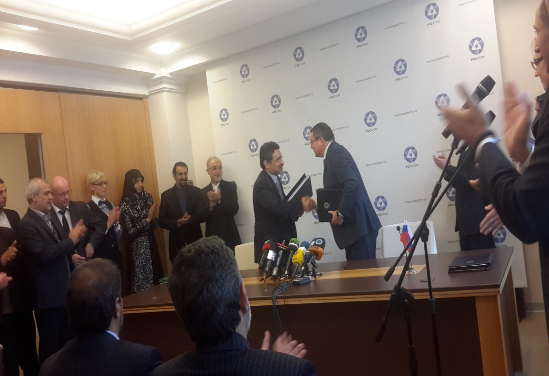
New Nuclear Units -BNNP 2 & 3
Nov. 11, 2014
Intergovernmental agreement signed between AEOI & Rosatom
Nov. 11, 2014
NPPD and ASE signed the contract
8

Slide 9
New Nuclear Units -BNNP 2 & 3
Technical requirements related to the construction of the new units
Technical requirements
GEN 3+, PWR reactors, 60 years life-time
Standardization ⇒ shorter licensing and construction time
Shorter maintenance period
Longer fuel cycles (extend to 18 months)
Less radioactive waste
More than 90 % LF (in base load operation mode)
Combined with the desalination plant
Safety increasing solutions
Passive safety systems
Mitigation and prevention of severe accidents
Higher protection against internal and external events
High volume and strong pre-strested concrete containment
Long term and reliable containment cooling
Equipped with core catcher
Independent safety systems including power supply
Increased passive safety systems
Hydrogen removal by passive re-combinors
Mobile EDGs & Diesel pump
Protection against external hazards
Seismic hazards
Extrem meteorology
Airplane crash
Accidents form other industrial sources
Electromagnetic interference

Slide 10
New Nuclear Units -BNNP 2 & 3
Main technical specification
Reactor type: AES-92 (Modified 2008)
Thermal power, 3012 MWe
Electric power, 1057 MWe
Efficiency , > 35 %
Power consumption, 83 MWe
Total availability factor, 93 %
Plant design service life, 60 years

Slide 11
Expectations and needed further assistance from the IAEA in successful planning and construction of 2 new large scale PWR units at Bushehr site
Further strengthening owner’s capabilities by focus mainly on:
  Safe and reliable utilization of NPPs,
  Safety aspects in performing independent reviews of preliminary safety analysis, site specific seismic safety and environmental impacts, based on the latest international safety standards and practices.
  Safety aspects of assessment and improvement of domestic industries capabilities and competencies for participation in construction activities
  HRD and WFP programmes review and implementation for different stages of NPP project
  nuclear technology, radiation safety, nuclear security and safety culture;
  specific technical support issues;
  radioactive waste management.

Slide 12
Challenges that impacted the implementation of some work plan activities in 2014
1. For effective planning and implementation of activities:
Timely submission of expectations, specific issues of interest, agenda, presentations, documents for review/consideration, list of participants, etc.
Date and venue of events – preferably for the whole year, including IAEA proposals and NPPD timely confirmation or alternatives taking into account holiday periods, other important events, etc.
Timely submissions through official channels of nomination forms of national experts for participation in events outside Iran with sufficient number and alternative candidates in order to avoid late withdrawals.
Considering alternative International experts in order to avoid last minute withdrawals/cancellations
2. Scientific Visit (SV) / Fellowship (FS):
Timely submission through official channels of all necessary documents/nomination forms with special attention to completion of requested information, e,g. needs, expectations, scope, specific issues of interest, potential host organizations, etc.
Regular feed-back on the status and progress and any needs for adjustments
Following up and take necessary measures to select proper host country (ies) to prevent of delay in implementation of SV/FS

Slide 13
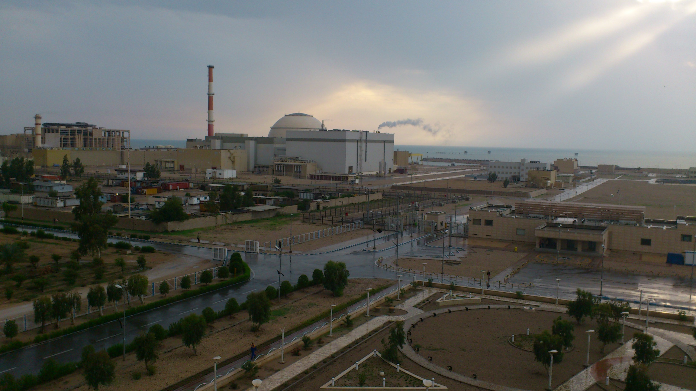
Thank you for your attention…

